Slide 1
INFO20003 Database Systems
Kuoyuan Li
Week 5

Slide 2
Agenda Today
Relational algebra (RA) review
2.Relational algebra and SQL statements

Slide 3
Relational algebra (RA) review
Relational Algebra
procedural query language for relational model
provide theoretical foundation for relational databases and SQL
consists of a collection of operators (unary/binary)
Five basic operators of Relational Algebra that can form other compound operators

Slide 4
Relational algebra (RA) review
Fundamental operations
Removal operators: Selection (𝜎) and Projection (𝜋)
Projection:
πA1, A2, ..., An (R) where R is relation and A are attributes that ‘projected’
Create new relation with a subset of attributes (remove columns)
All tuples are included, but only chosen attributes are kept
Projection operator has to eliminate duplicates

Slide 5
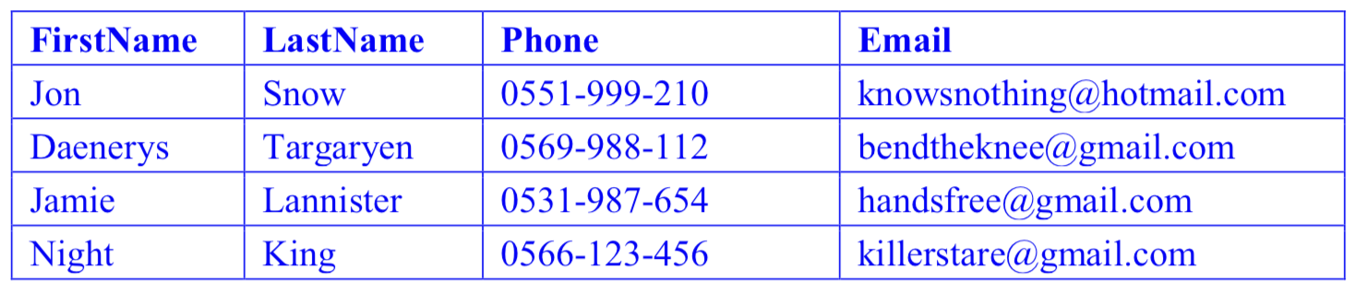
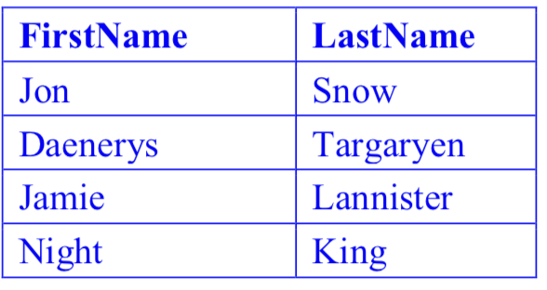
Relational algebra (RA) review
Projection Example

Slide 6
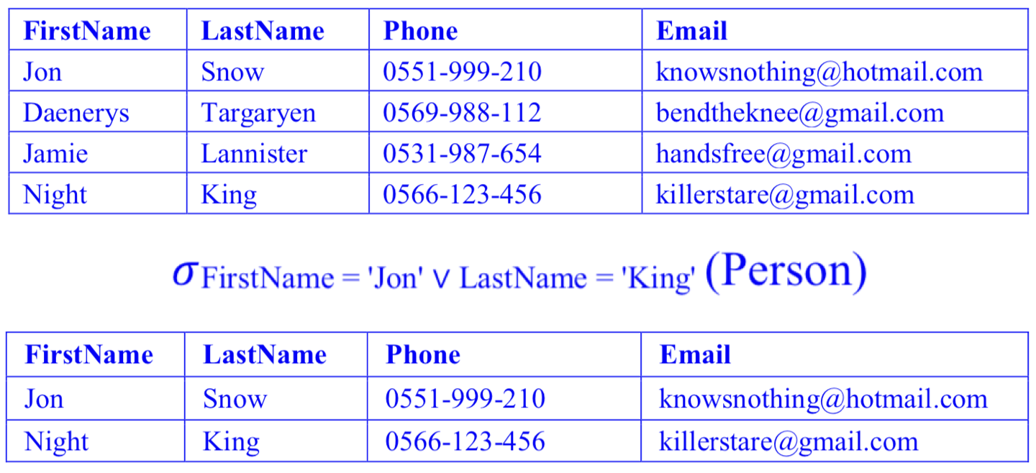
Relational algebra (RA) review
Selection:
σC (R) where R is relation and C is condition used to filter rows
Create new relation consisting of those rows for which C is true
Example

Slide 7
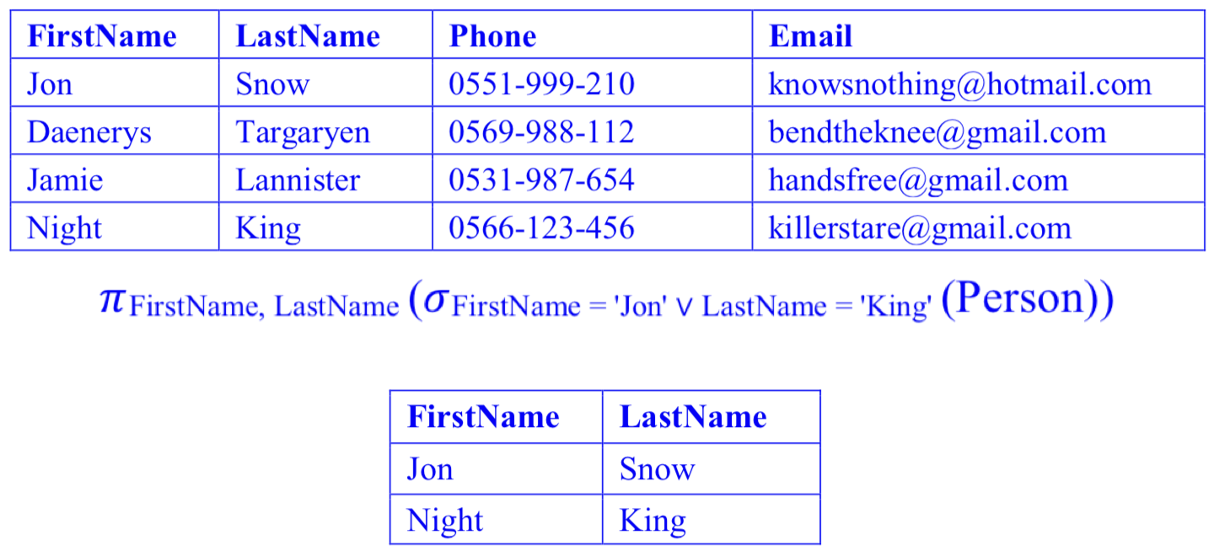
Relational algebra (RA) review
Selection Projection Combination

Slide 8
Relational algebra (RA) review
Fundamental operations
Set operators: Set-difference (–) and Union ( U )
constraint: both relations must have the same attributes with the same domains. the ordering of attributes should be kept consistent.
Set-difference:
R – S. result will be every row which is in R but not in S
Union:
R ∪ S. result will be every row which is either in R or S
Duplicates are removed

Slide 9
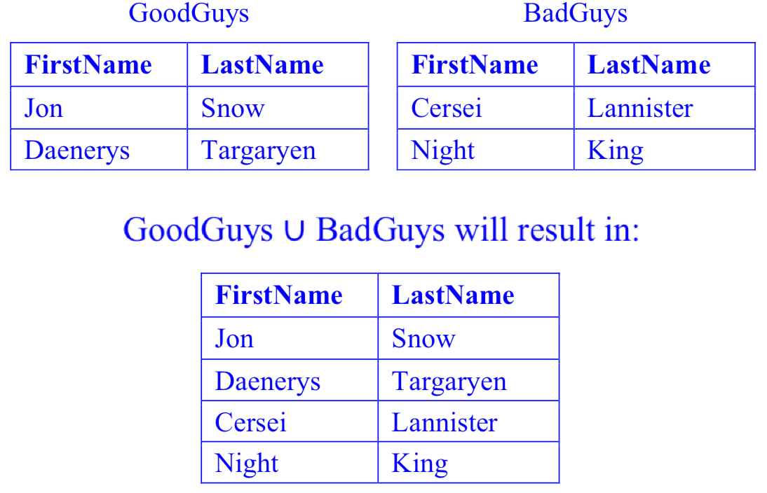
Relational algebra (RA) review
Union Example

Slide 10
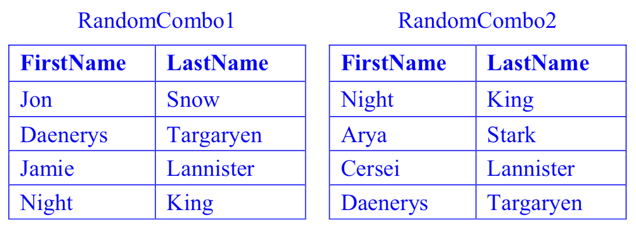
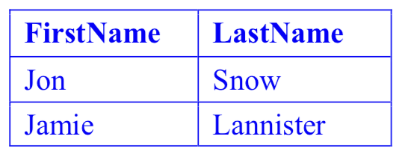
Relational algebra (RA) review
Difference Example

Slide 11
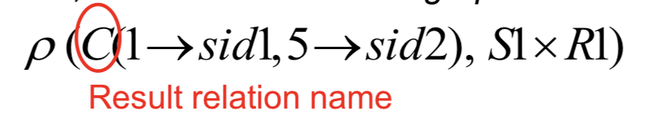
Relational algebra (RA) review
Fundamental operations
Set operators: Cross Product (×)
Cross Product (×):
Each row of R pairs with each row of S. The resulting schema has all the attributes from both relations. If some attributes have same name, rename them by using renaming operator.

Slide 12
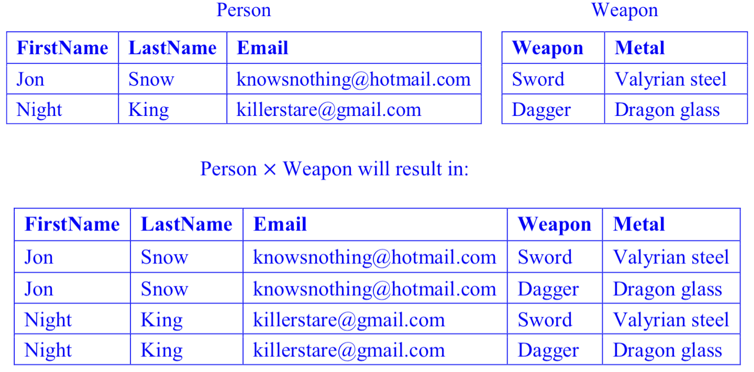
Relational algebra (RA) review
Cross Product Example

Slide 13
Relational algebra (RA) review
Compound operations
operators are not adding any computational power to the language but are useful shorthand.
All these operators can be expressed using the basic operators
Intersection(∩)
Natural Join(⨝)
Condition Join (Theta/Inner Join)

Slide 14
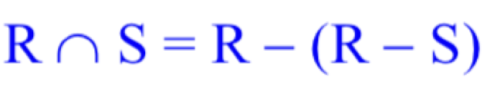
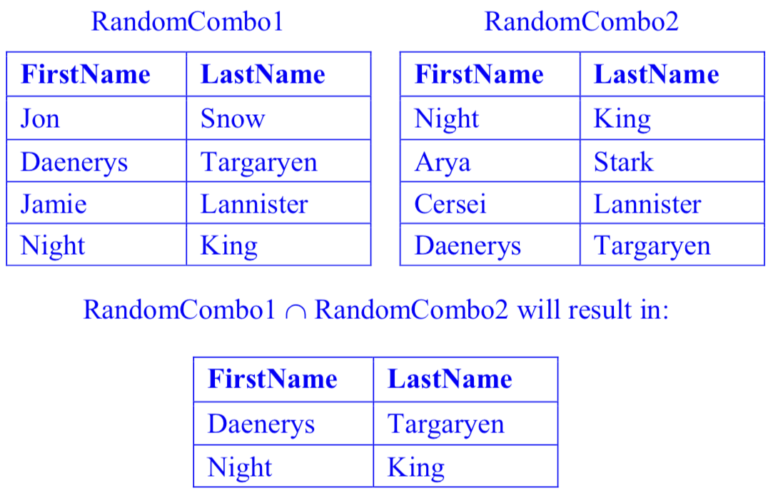
Relational algebra (RA) review
Intersection (∩):
union compatible
result is a relation containing all the tuples which are present in both relations
Intersection Example

Slide 15
Relational algebra (RA) review
Natural Join(⨝):
identifies attributes common to each relation
pairing each tuple from R and S where the common attributes are equal
In general are compound operators involving cross product, selection and occasionally projection
omit duplicate attributes
steps:
Compute R × S
Select rows where attributes that appear in both relations have equal values.
Project all unique attributes and one copy of each of the common ones.

Slide 16
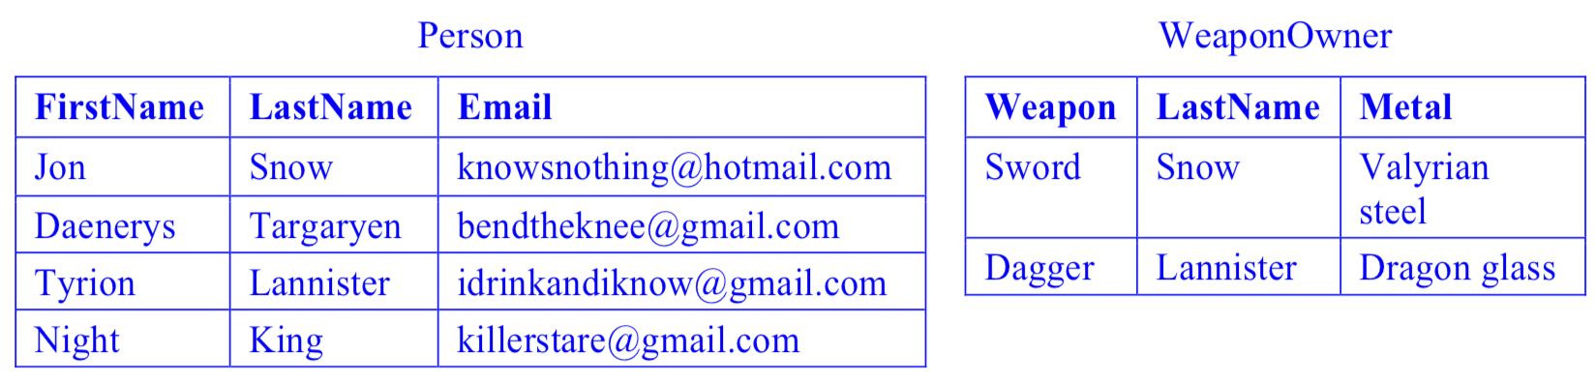
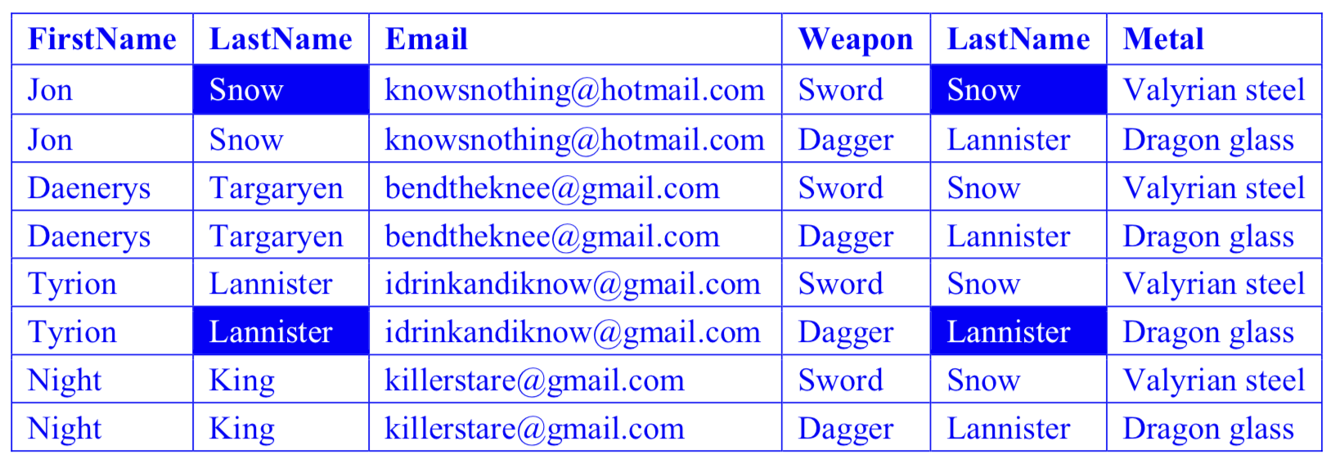
Relational algebra (RA) review
Natural Join Example

Slide 17
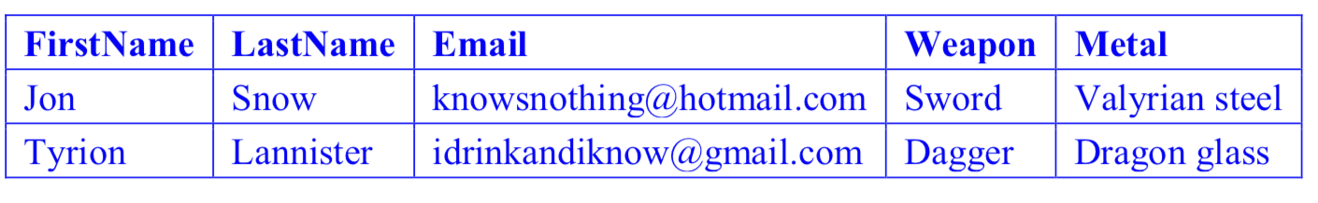
Relational algebra (RA) review

Slide 18
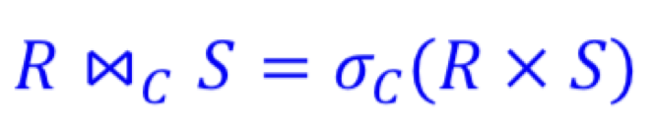
Relational algebra (RA) review
Condition Join (Theta/Inner Join)
Condition Join(⨝C) steps:
R ⨝C S joins rows from relation R and S such that the Boolean condition C is true
commonly C is of the type A = B, making an “equi-join”.

Slide 19
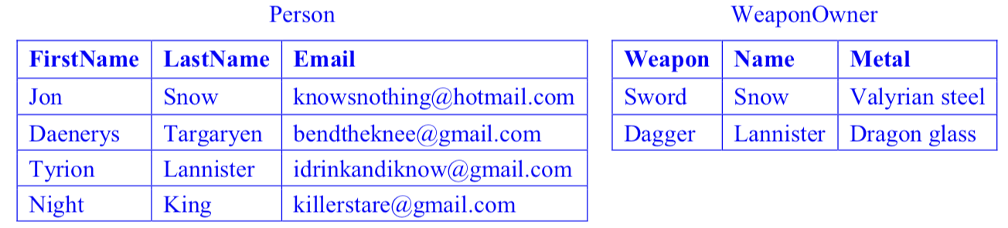
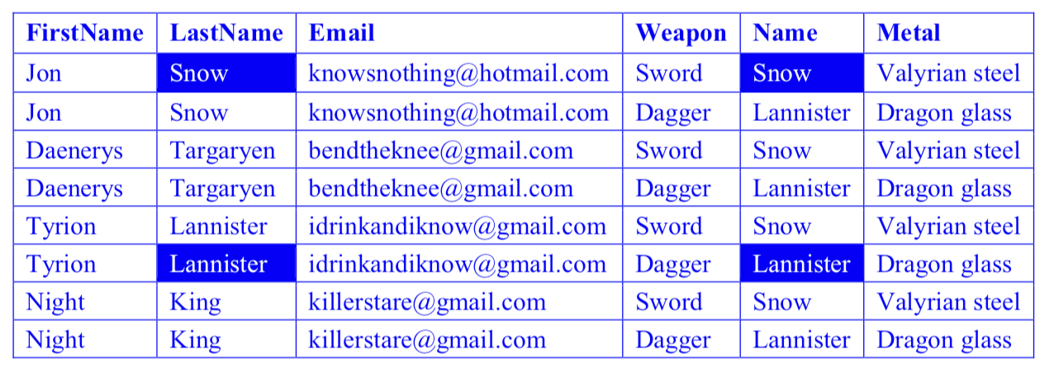
Relational algebra (RA) review
Condition Join Example

Slide 20
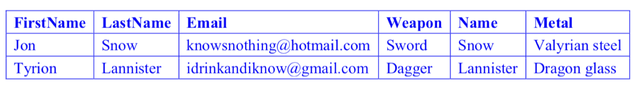
Relational algebra (RA) review

Slide 21
Relational algebra (RA) review
Any questions?

Slide 22
Structured Query Language(SQL) review
Structured Query Language(SQL)
Domain-specific language
Language for data manipulation in relational databases
Allow to create/delete tables, add/update/remove data, etc

Slide 23
Structured Query Language(SQL) review
Structured Query Language(SQL)
Data Definition Language (DDL): To define and setup the database
CREATE, ALTER, DROP
Data Manipulation Language (DML): To maintain and use the database
SELECT, INSERT, DELETE, UPDATE
Data Control Language (DCL): To control access to the database,
GRANT, REVOKE
Other Commands: Administer the database, Transaction Control

Slide 24
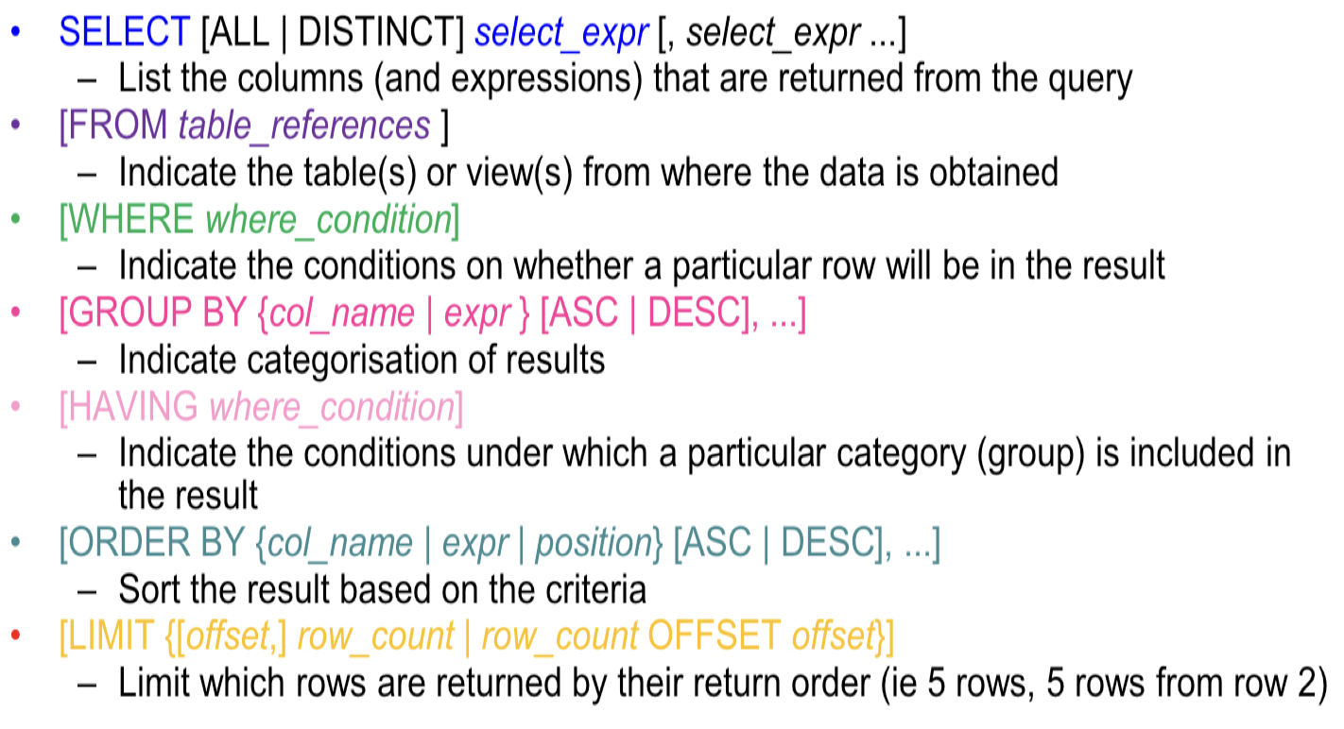
Structured Query Language(SQL) review
Structured Query Language(SQL)
DML – SELECT statements

Slide 25
Structured Query Language(SQL) review
Any questions?

Slide 26
Case study
Group/Individual case study
I will randomly assign you to a breakout room
1. Already have a study group/Want to do it with a friend?
Choose the room where you friends in and jump into it
2. Don’t want be in a group for now?
Although I strongly encourage you to do it in a group, if you want to do it alone, you can come to the main room and mute yourself.

Slide 27
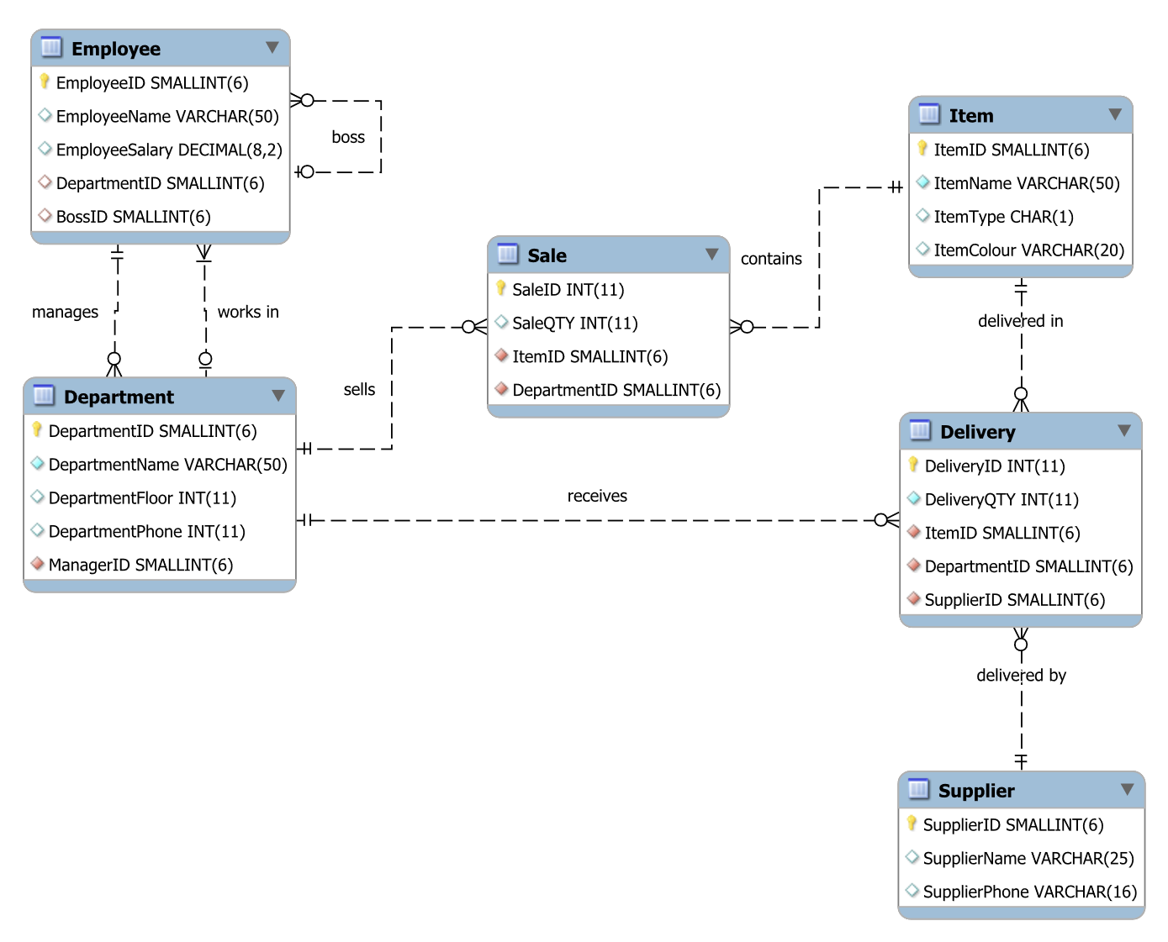
Case study
Consider the following schema:

Slide 28
Case study
Solve the following problems using relational algebra (RA) and translate to SQL statements:
Find the names of all employees.
Find the names of all employees in department number 1.
List the names of green items of type C.
Find the items sold by the departments on the second floor (only show ItemID).
Find the names of brown items sold by the Recreation department.
Find the employees whose salary is less than half that of their managers.

Slide 29
Case study
a. Find the names of all employees.

Slide 30
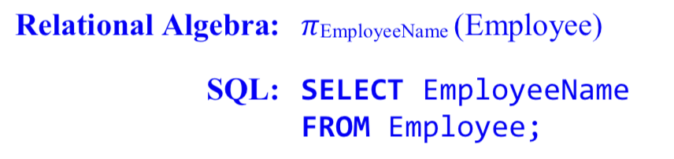
Case study
a. Find the names of all employees.

Slide 31
Case study
b. Find the names of all employees in department number 1.

Slide 32
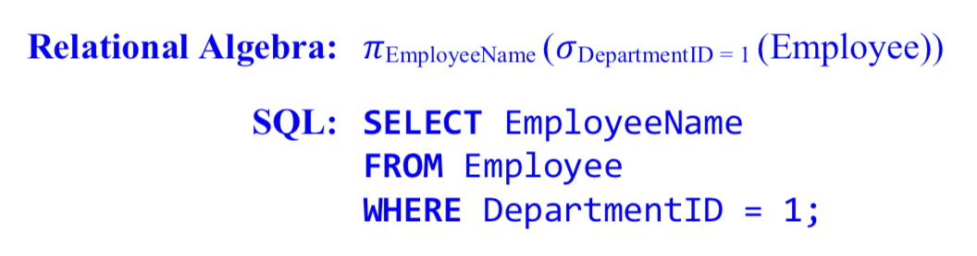
Case study
b. Find the names of all employees in department number 1.

Slide 33
Case study
c. List the names of green items of type C.

Slide 34
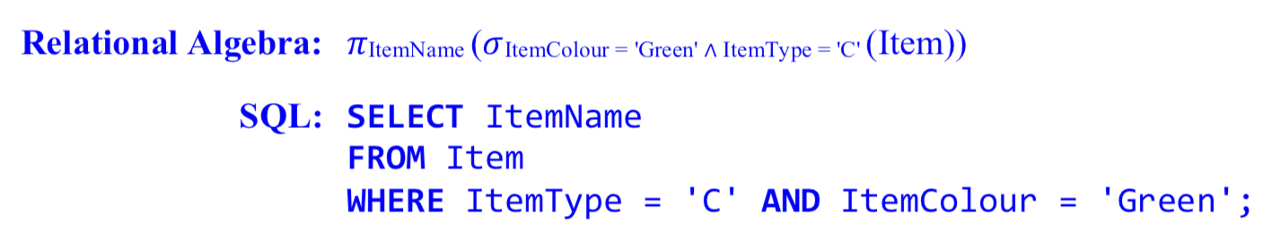
Case study
c. List the names of green items of type C.

Slide 35
Case study
d. Find the items sold by the departments on the second floor (only show ItemID).

Slide 36
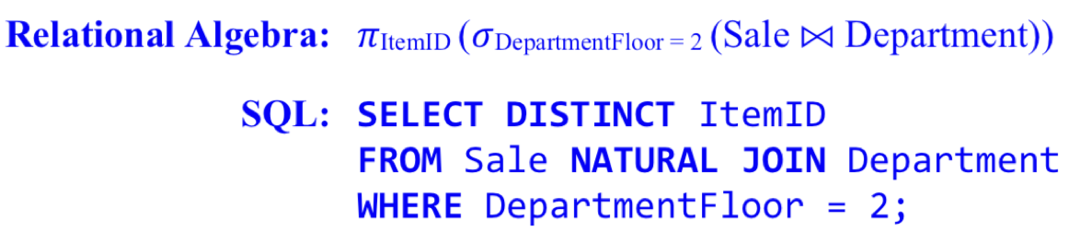
Case study
d. Find the items sold by the departments on the second floor (only show ItemID).

Slide 37
Case study
e. Find the names of brown items sold by the Recreation department.

Slide 38
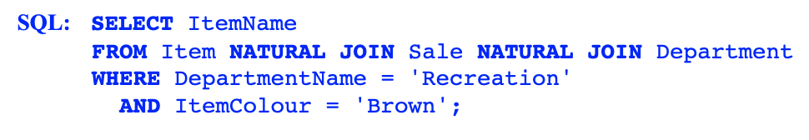
Case study
e. Find the names of brown items sold by the Recreation department.
Relational Algebra:

Slide 39
Case study
f. Find the employees whose salary is less than half that of their managers.

Slide 40

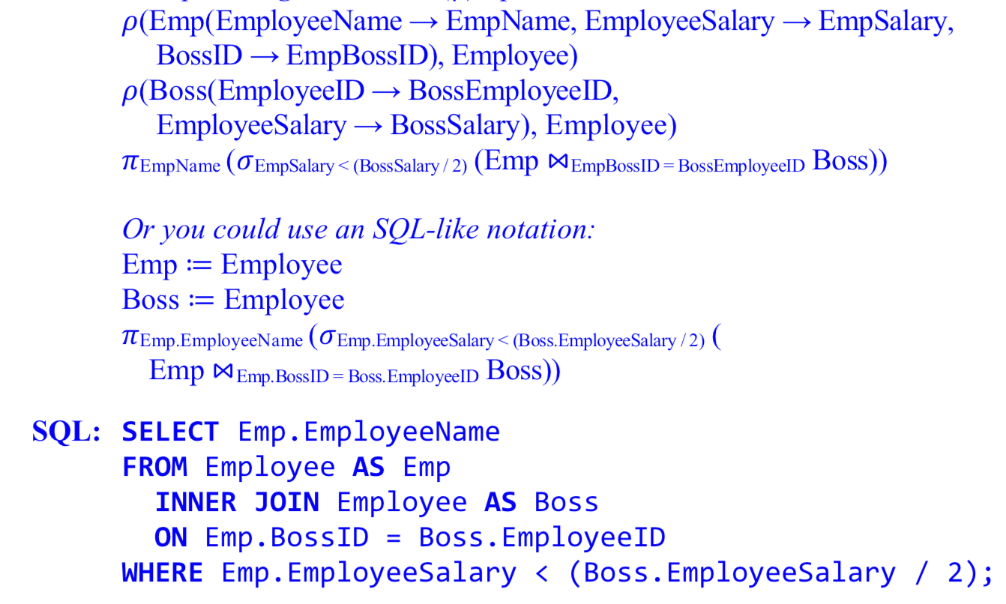
Case study
f. Find the employees whose salary is less than half that of their managers.

Slide 41
Case study
Any questions?

